Slide 1
Hydrogen Fuel Cell Vehicle
Nora Jiang and Matthew Shiley
Professor Carr Everbach

Slide 2
Table of contents
01
02
03
Introduction
Current
Project
Future
Considerations

Slide 3
01
Introduction
What is a HFCV? And why is there one sitting in the hallway?

Slide 4
What you need to know first
Hydrogen (H₂) as a fuel?
Why switch to H₂
H₂ is an energy carrier (like gasoline)
Energy is produced through electrolysis
Stored as a liquid before entering the fuel cell
H₂ is incredibly energy dense
Clean in comparison to gas
Large range before needing to refuel

Slide 5
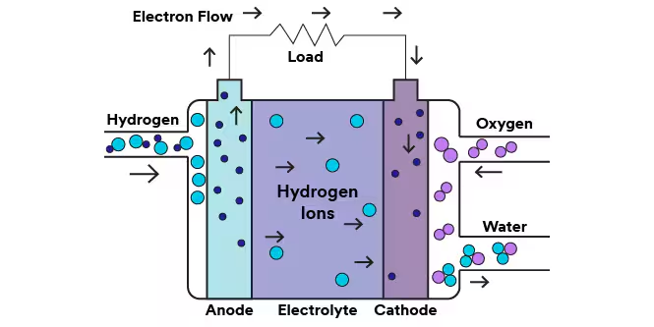
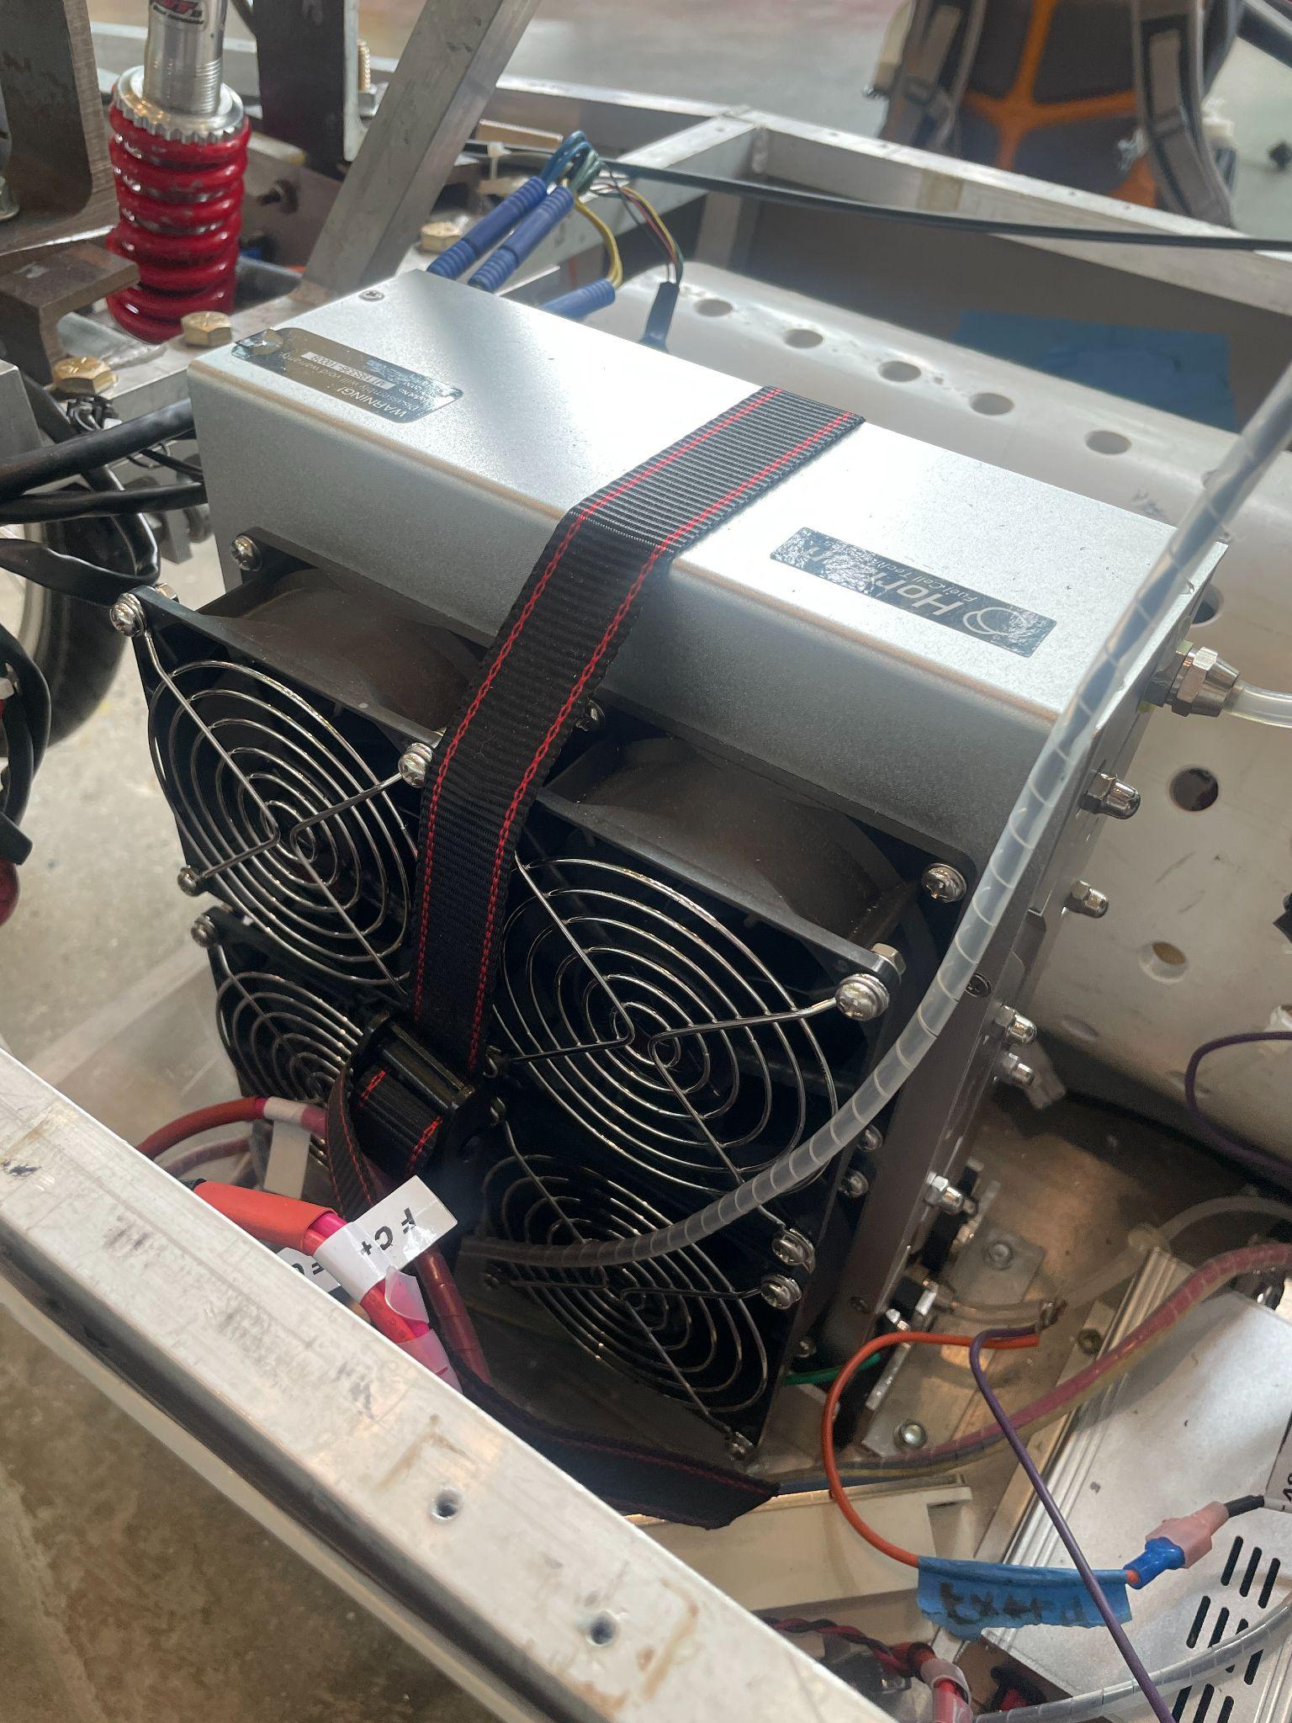
Inside the Fuel Cell
Our Actual Fuel Cell
Photo Courtesy of 3M

Slide 6
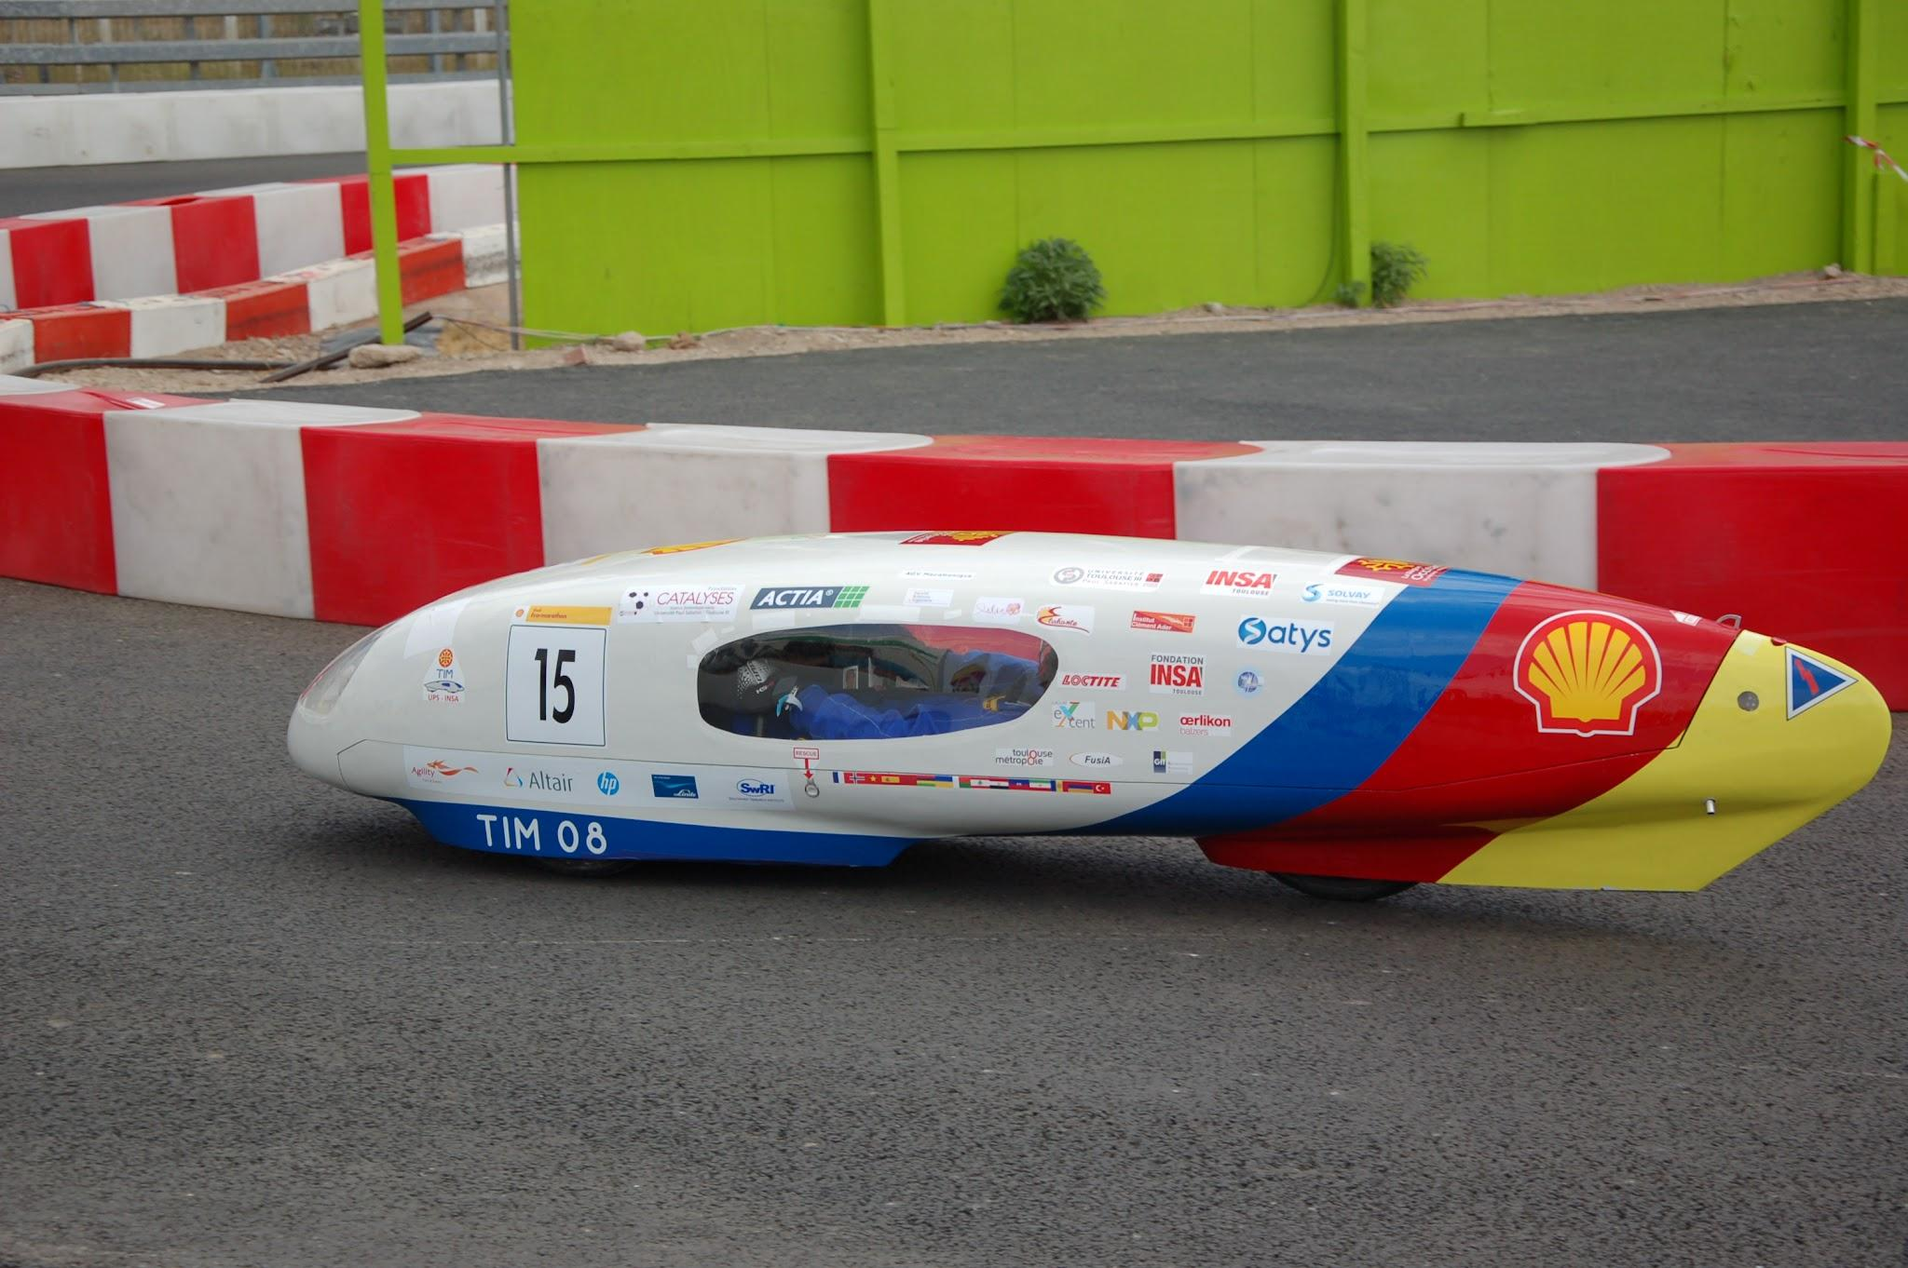
Shell Eco Marathon
What Is It?
Competition to make the most energy efficient vehicle
Why Compete?
Gives a target for our work on the vehicle
Photo Courtesy of Shell Eco Marathon

Slide 7
02
Current Project
Rebuilding the Chassis, pt. 2

Slide 8
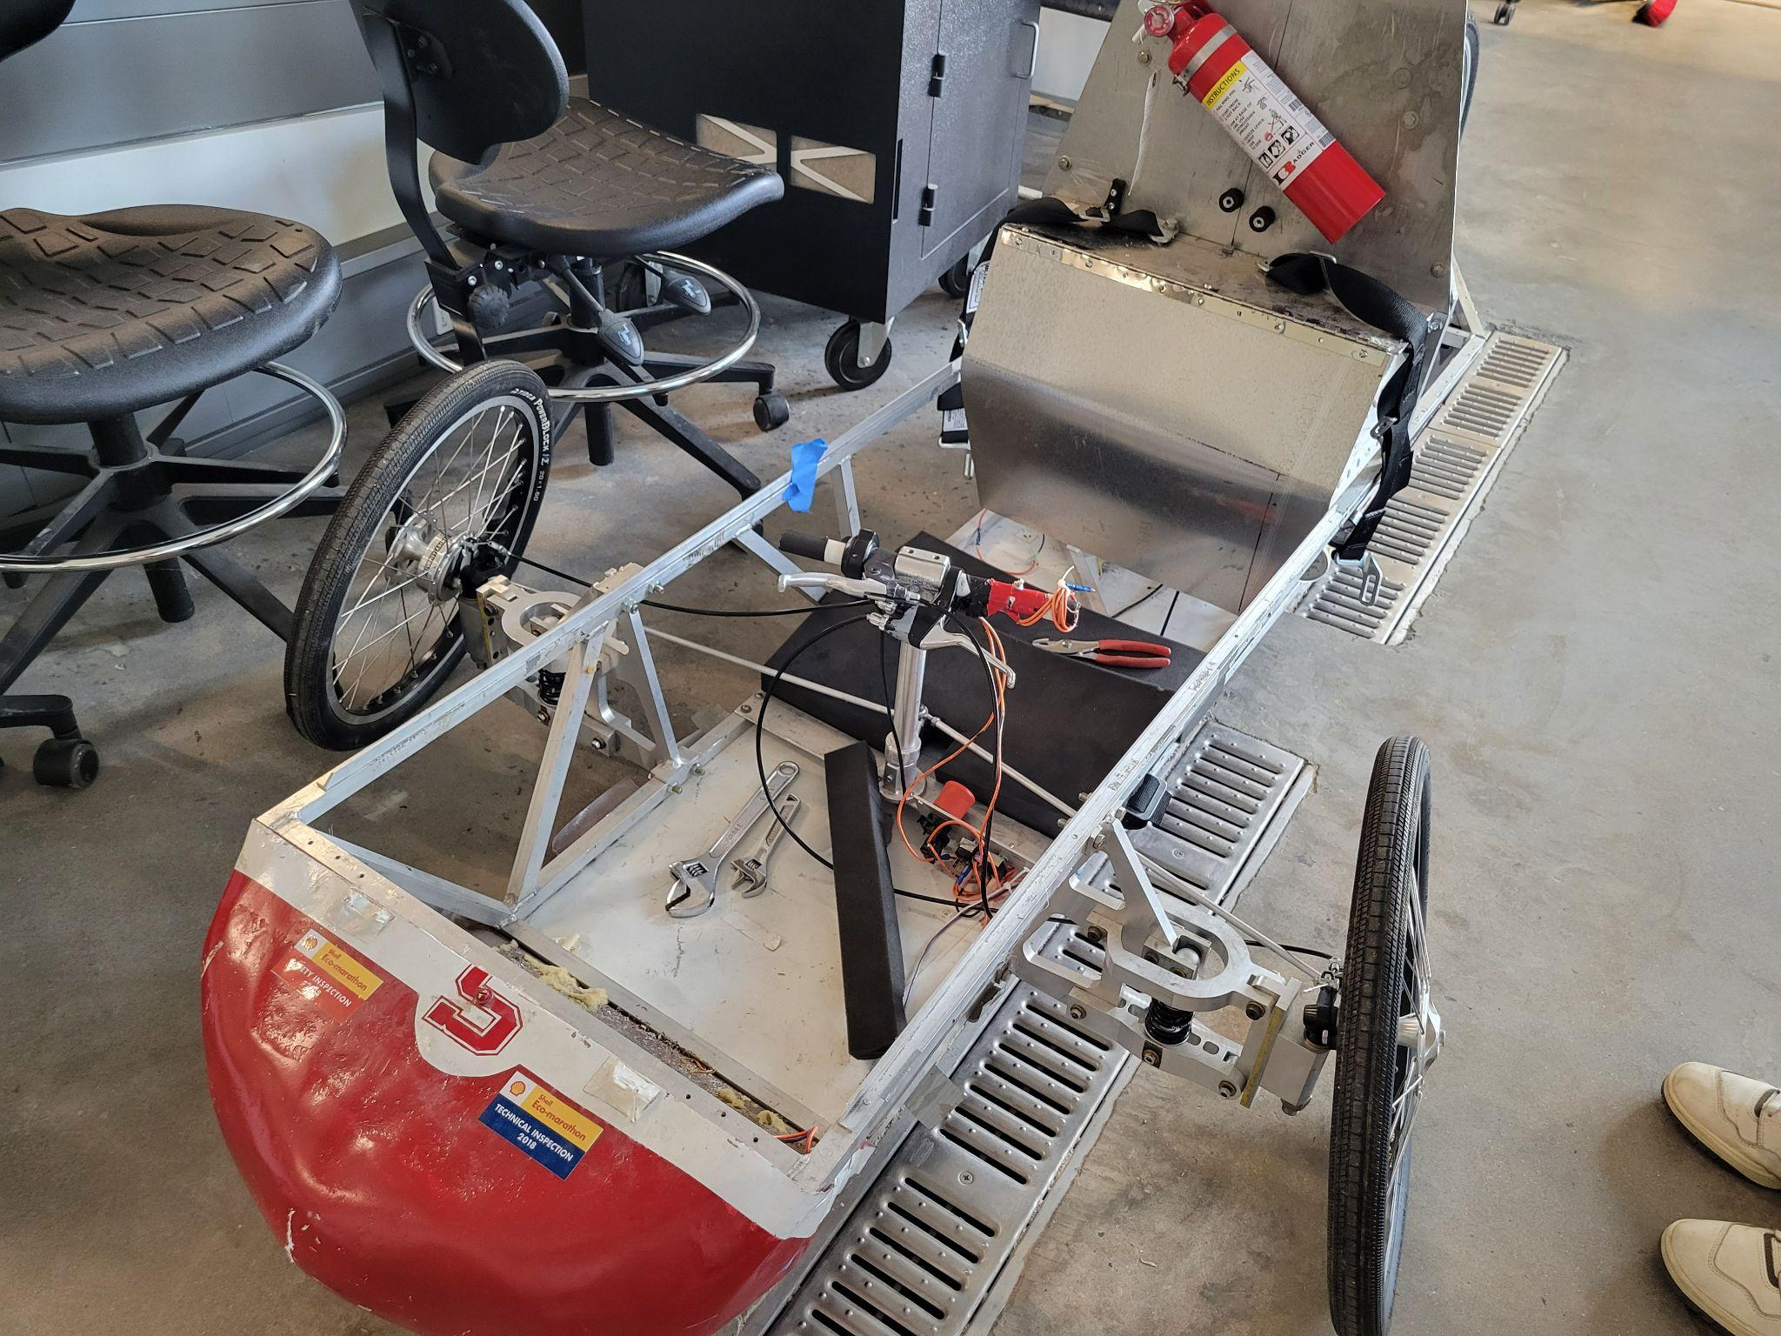
Before This Summer
Previous vehicle
  No longer adheres to Shell’s safety standards
  Needs a complete rebuild before competition ready
Revitalization: 2023-2025
  Materials testing
  Preliminary Chassis Design
  Rear Brakes and Suspension system
  New Braking system
  Steering components

Slide 9
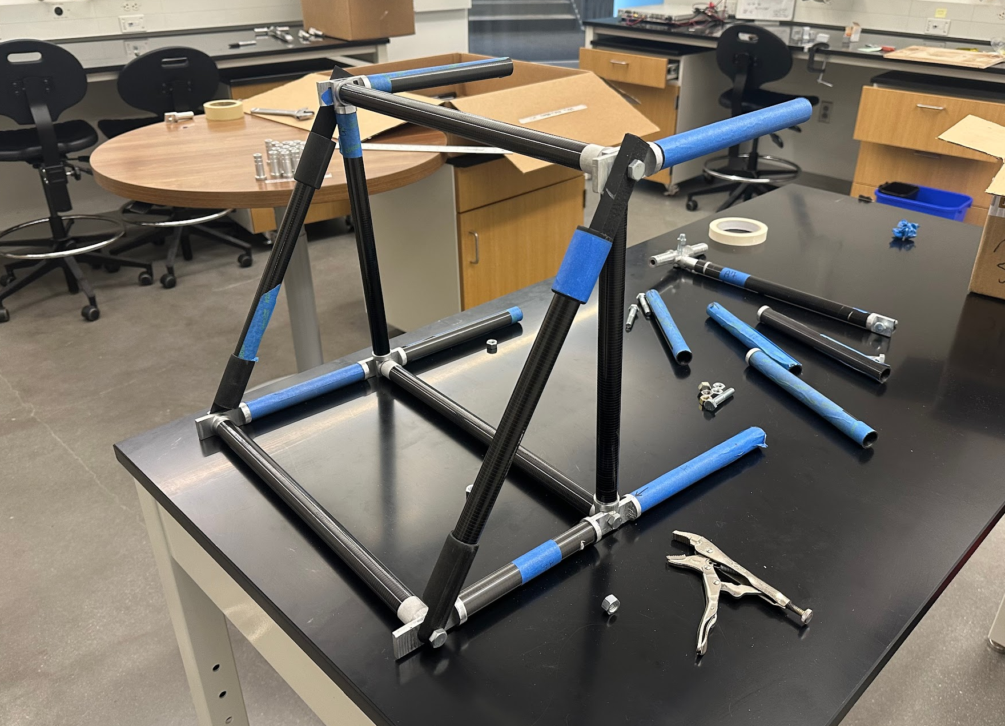
Progress So Far!

Slide 10
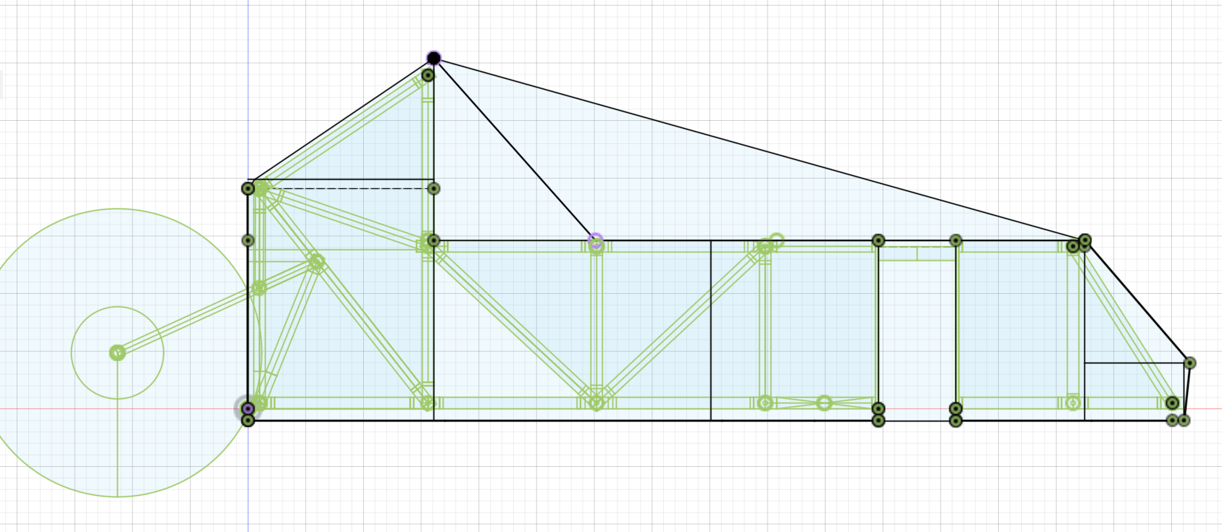
Rough Chassis Design Plan

Slide 11

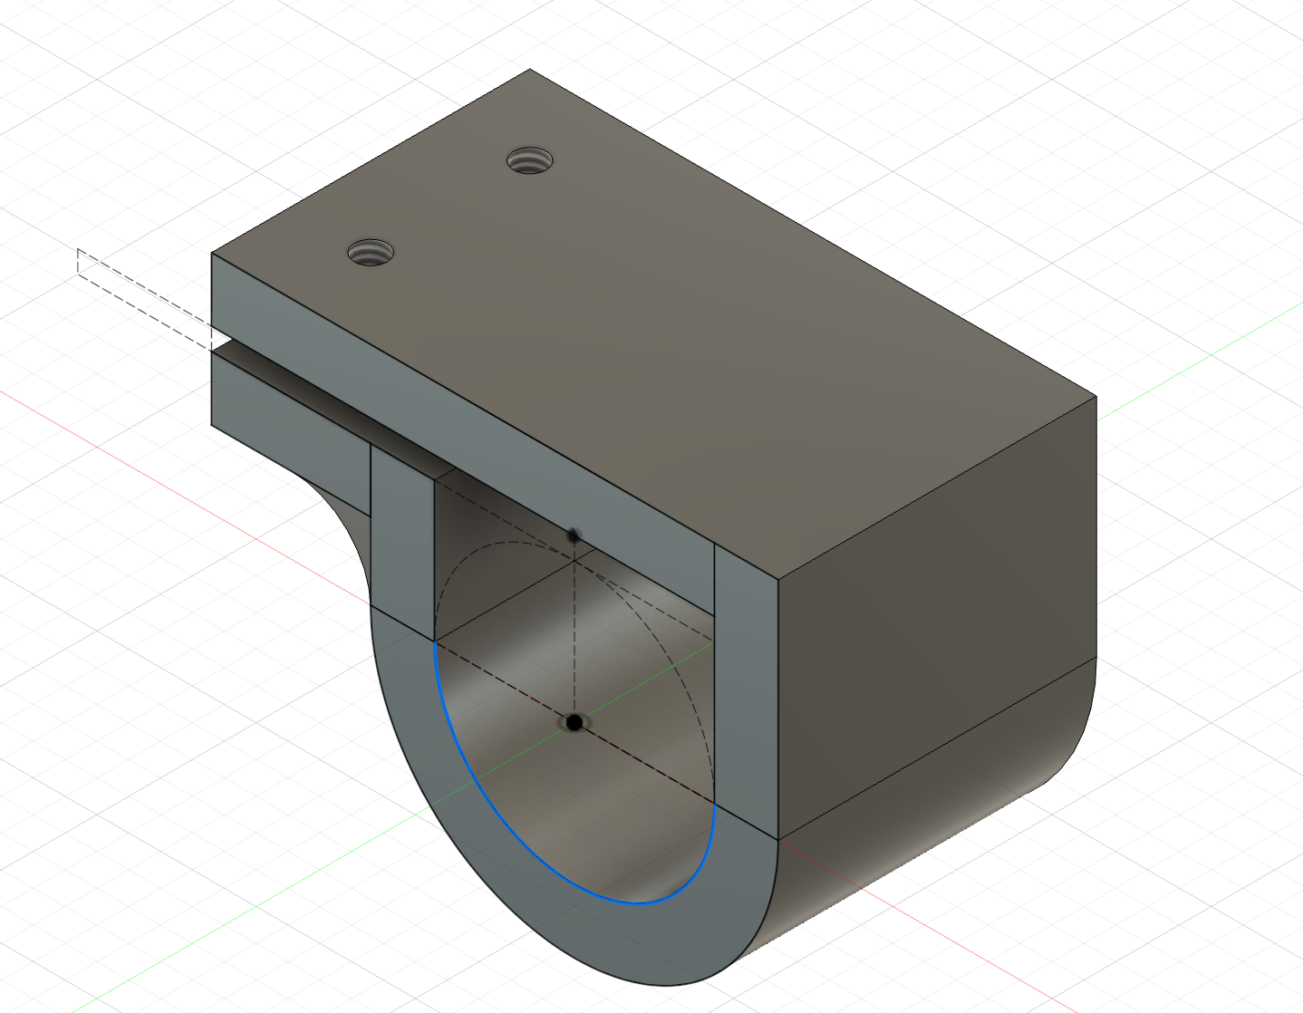
3D Printed Clips

Slide 12
03
Future Considerations
Rebuilding the rest of the HFCV

Slide 13
The Next Year (or so)
Putting it all together
Compete
Chassis + Cowl
+
Mechanical Components
Transport Team and Car to Indiana
Testing
Testing entire system to the Shell Eco Marathon Requirements

Slide 14
Thank you for listening
Questions, Comments, Concerns?
njiang1@swarthmore.edu
mshiley1@swarthmore.edu
avasque1@swarthmore.edu
ceverba1@swarthmore.edu

